Slide 1
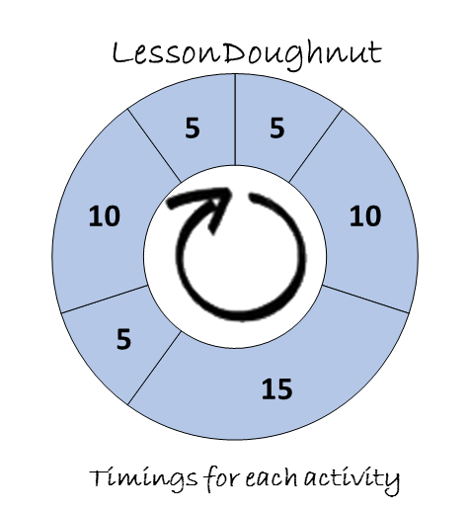
(Add your own content here)

Slide 2
(Add your own content here)

Slide 3
(Add your own content here)

Slide 4
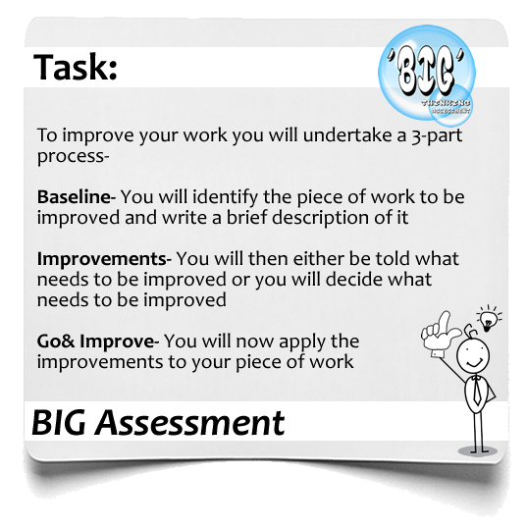
(Add your own content here)

Slide 5
(Add your own content here)

Slide 6
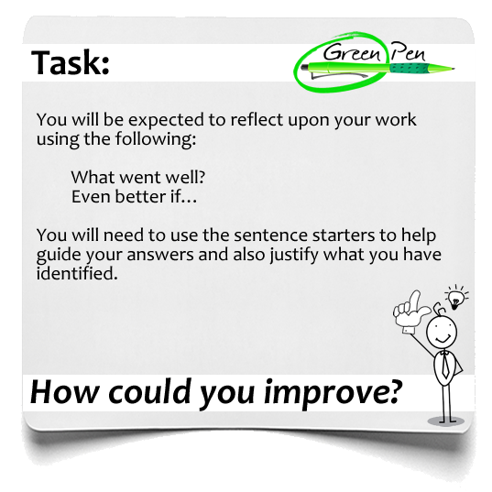
(Add your own content here)

